Slide 1
WI：SLB-mmW meeting # Initial Thoughts on SLB-mmW
Date: 2024-11-19
Source:
Affiliation | Contact | Email
Lenovo (Beijing) Software Co. Ltd | Jianfeng Wang | wangjf20@lenovo.com

Slide 2
Contents
Motivation
General requirements
Candidate technologies

Slide 3



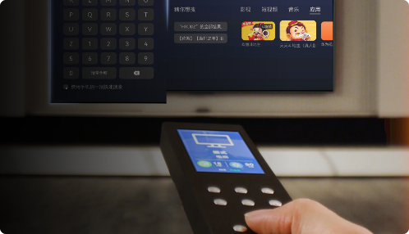



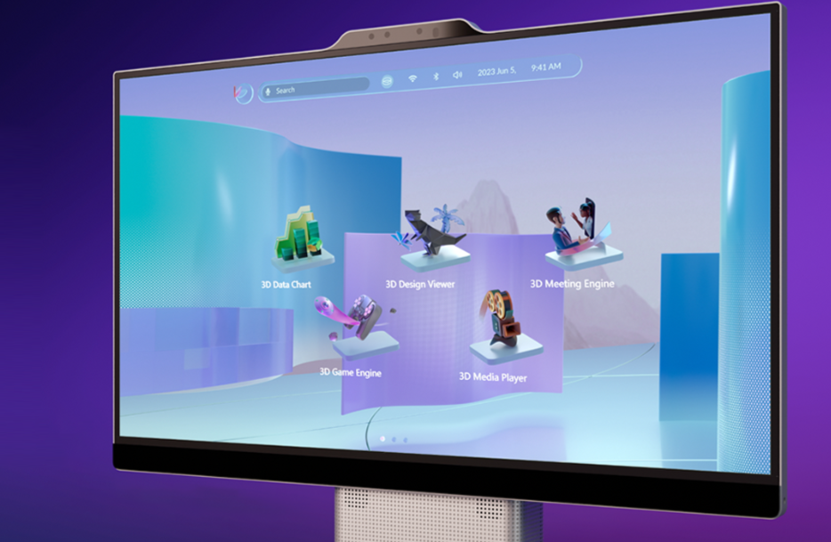
Motivation
Successful applications of SLB/SLE 1.0
Car key, Tablet pen, Mouse, Remote controller, …
New applications are arising
XR glass, immersive communication, digital twin, 8k video…
Figures from: https://www.hisilicon.com/cn/techtalk/nearlink

Slide 4
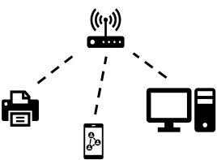
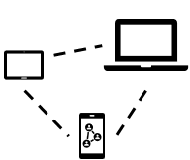
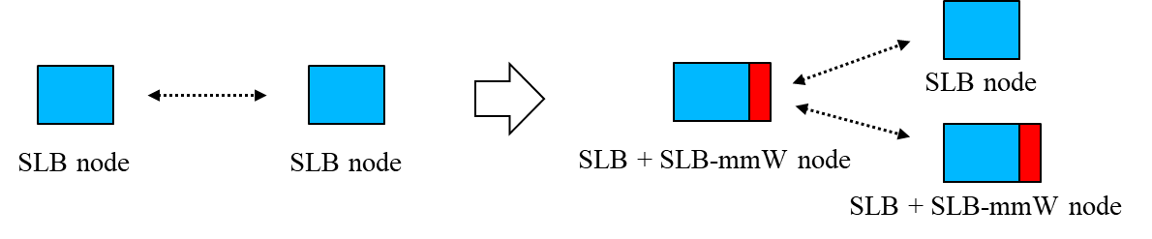
General requirements
Key performance
Higher data rate, e.g., ~20Gbps
Lower latency, e.g., <5ms
Higher reliability, e.g., PER < 10⁻³
Compatibility
Forward compatible
Network topology
Central-controlled
Peer-to-peer
Mesh

Slide 5
Candidate technologies
Numerology
Carrier aggregation
Beamforming schemes

Slide 6
Numerology considerations
Due to the large bandwidth in mmWave, it is necessary to consider studying new numerologies.
Option 1: Increase SCS with the same number of subcarriers/FFT size
Option 2: Increase the number of subcarriers/FFT size with the same SCS
BW | 20MHz | 40MHz | 80MHz | 160MHz
Sample rate | 30.72M | 61.44M | 122.88M | 245.76M
FFT size | 256 | 512 | 1024 | 2048
SLB 1.0bis:
Option 1: SCS=1.92MHz, same FFT size
Option 2: SCS=120kHz, larger FFT size
BW | 320MHz | 640MHz | 1280MHz | 2560MHz
Sample rate | 491.52M | 983.04 | 1966.08M | 3932.16M
FFT size | 256 | 512 | 1024 | 2048
BW | 320MHz | 640MHz | 1280MHz | 2560MHz
Sample rate | 491.52M | 983.04 | 1966.08M | 3932.16M
FFT size | 4096 | 8192 | 16384 | 32768
Recommend increasing SCS, e.g., 1.92MHz, with the same FFT size set to support the larger bandwidth in mmWave.

Slide 7
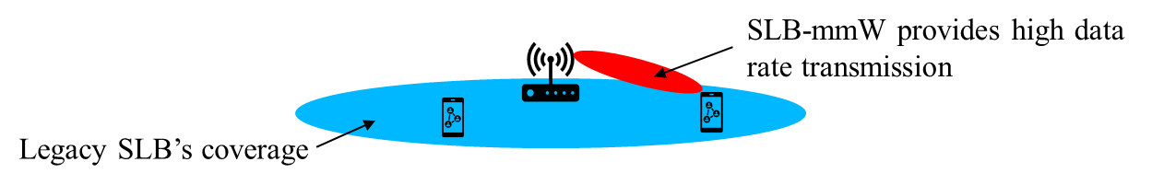
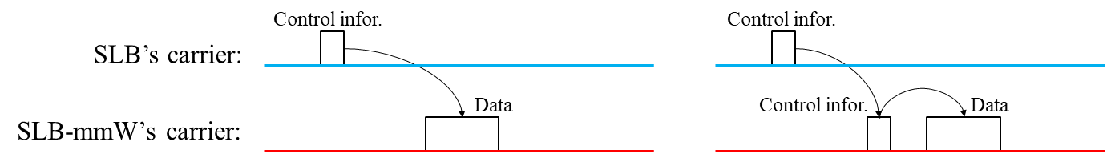
Carrier aggregation
Consider the efficient utilization of the lower frequency band, i.e., for legacy SLB, and higher frequency bands for SLB-mmW.
To guarantee the coverage and anchor connection by legacy SLB, provide high data rate transmission via SLB-mmW.
Study schemes to support flexible inter-carrier scheduling between legacy SLB and SLB-mmW.

Slide 8
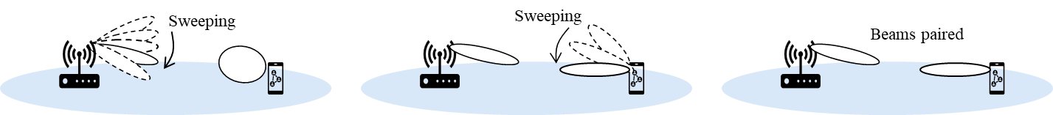
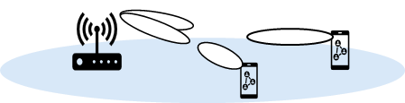
Beamforming schemes
In mmWave, beamforming is always used with multiple antennas to compensate the path loss and improve receiving SINR.
Study efficient beams pairing, switching and recovering schemes with low signaling overhead and latency.
Study the beamforming schemes to support multiple users scheduling, i.e., MU-MIMO
An example of a beam pairing procedure, i.e., sweep, measure, report and selection
MU-MIMO support

Slide 9
Summary
New arising applications, e.g., XR, motivates the development on SLB-mmW to support higher data rate, lower latency and high reliability.
E.g., >20Gbps, <5ms latency and PER<10⁻³.
Suggested to initially study the numerology, carrier aggregation and beamforming schemes.
Recommend larger SCS to support wide bandwidth with same FFT size set
Study carrier aggregation to support inter-carrier scheduling between SLB and SLB-mmW.
Study beamforming schemes to support efficient beam management and MU scheduling

Slide 10
References
[1] xxx

